Slide 1


Open Access - Seeking balance
Summary of Day One
Eva Hnátková, Eurodoc President
KRECon 2019
NTK in Prague
7-8 November 2019
eva.hnatkova@eurodoc.net
@EvaHnatkova | eurodoc.net
01

Slide 2
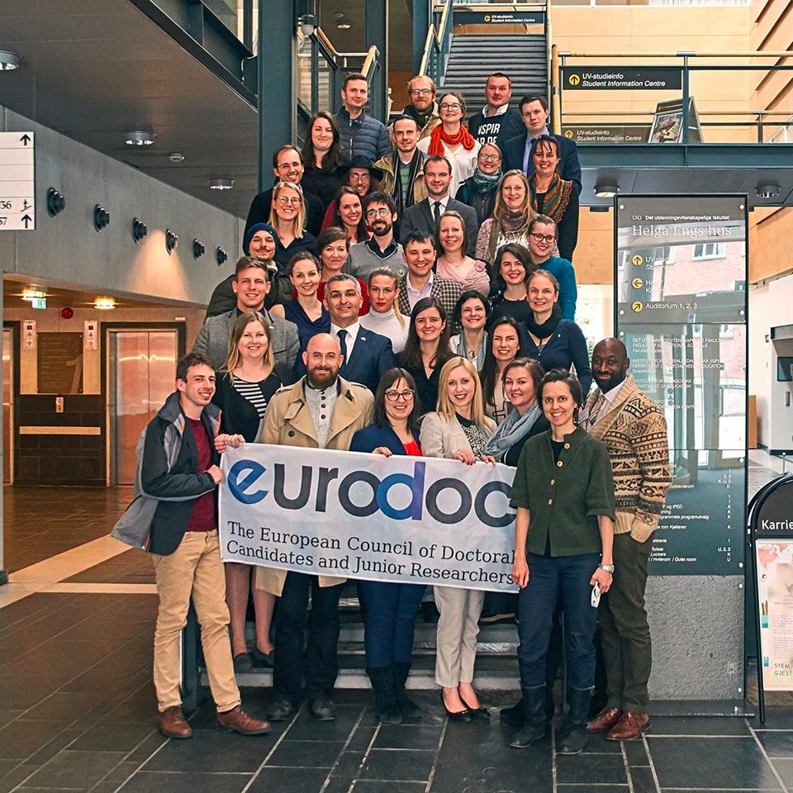
Eurodoc = early-career researchers
non-profit organisation
based in Brussels (2002)
28 national associations
funded by member fees
supported by volunteers
develop & inform policy
run workgroups & events
O’Neill & Krūmiņa (2018)
eva.hnatkova@eurodoc.net
@EvaHnatkova | eurodoc.net
02

Slide 3
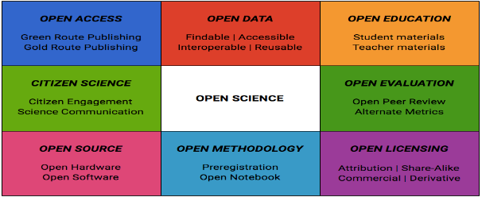
Open Science
Masuzzo & Martens (2017) | FOSTER Taxonomy of Open Science
eva.hnatkova@eurodoc.net
@EvaHnatkova | eurodoc.net
03

Slide 4

Open access
eva.hnatkova@eurodoc.net
@EvaHnatkova | eurodoc.net
04

Slide 5

Open Access via Plan S
Plan S = cOAlition S
national funders
science publications
all in Open Access
full and immediate
10 core principles
by 01 January 2021
Plan S
05
eva.hnatkova@eurodoc.net
@EvaHnatkova | eurodoc.net

Slide 6


Negotiations
National Library of Sweden
eva.hnatkova@eurodoc.net
@EvaHnatkova | eurodoc.net
6

Slide 7

Czech Landscape
National Strategy 2017-2020 → requires OA
Action Plan for implementation (Apr 2019)
Open/FAIR data policy
Reviewing Research Assessment
(external influence → governments, funders, competitive environment)
Transfer the current publishing system subscription-based → to gold open access
eva.hnatkova@eurodoc.net
@EvaHnatkova | eurodoc.net
07

Slide 8
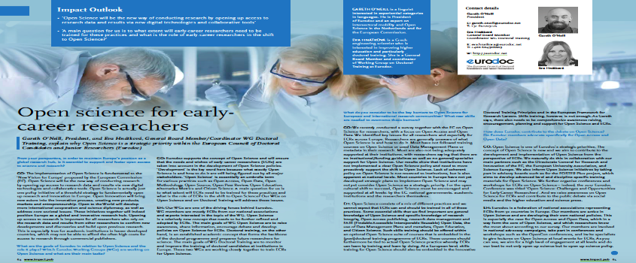
Train, support, & reward Open Science
O’Neill & Hnátková (2018)
eva.hnatkova@eurodoc.net
@EvaHnatkova | eurodoc.net
08

