Slide 1



Open Access:
A Scientist´s Perspective
Peter H. Seeberger

Slide 2
Why Do Scientists Publish ?
1) Disemminate research results
2) Get feedback from peers
3) Establish record – basis for promotions, awards etc.
Notes:
The synthesis of DNA changed everything…

Slide 3

Subscription or Open Access?
1) Subscription = reader pays
2) Open Access = author pays
3) Both pay = maximum return
4) 1) – 3) → What is a „fair“ prize ??
5) Neither pay = Platinum Open Access
Notes:
The synthesis of DNA changed everything…

Slide 4
Technology Changes Everything!
1) Data storage and disemmination possible for anybody
2) Costs drastically reduced
3) Data can be reported in different ways (original data!)
4) Review process can be changed
5) Why do we need journals anymore ?
Impact factors and H-indices are easier to count than
to really understand and judge science!
Notes:
The synthesis of DNA changed everything…

Slide 5
Revolutionizing Data Disemmination
1) Some top journals remain
2) Living articles and blogs
3) Better ways to judge impact and reception
Change will have to come from the top scientists
and the top institutions
Notes:
The synthesis of DNA changed everything…

Slide 6
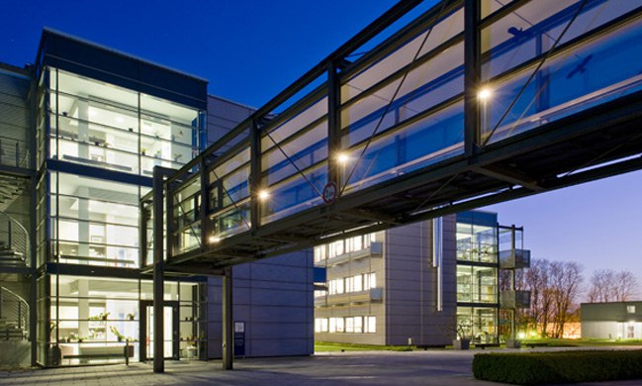
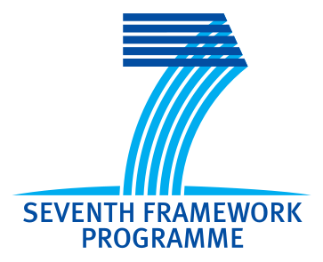
Thank You!
Peter.seeberger@mpikg.mpg.de
www.peter-seeberger.de
Twitter @peterseeberger

