Slide 1
Towards Open Science: Challenges and Way Forward for European universities
Professor Jean-Pierre Finance
Chair of the EUA Expert Group Science 2.0/Open Science and EUA High-Level Group on Big Deals
#OpenScience
#OpenAccess
#ResearchAssessment

Slide 2
EUA : An Introduction
Represents universities and national rectors’ conferences in 48 European countries.
Guarantees the hearing of the European Universities’ independent voice and the decisions that will impact their activities positively.
Provides a unique expertise in higher education and research; it is also a forum for exchange of ideas and good practices among universities.
More information:
https://eua.eu

Slide 3
EUA R&I Committees (Sep 19) Mobilises 137 high-level representatives from 95 universities in 30 European countries
EUA Board
EUA Council
Research Policy Working Group (RPWG)
Paul Boyle
General R&I policy development, ERA, HEu, strategic partnerships, relations with EC-EP
EUA Council for Doctoral Education
(EUA-CDE) Steering Committee
Luke Georghiou
Expert Group on Science 2.0/Open Science &
High-Level Group on Big Deals
Jean-Pierre Finance
Innovation Ecosystems Expert Group
Peter Haring Bolivar
EUA Energy & Environment Platform
(EUA-EPUE) Steering Group
Douglas Halliday

Slide 4
Open Science : Aims, Expectations and Hurdles

Slide 5
Regulatory framework
Scientific
Publications
Research Data
Research methods
Expectations
Fast-track development
Need to publish
- Carreer managment
- Research funding
Nb researchers
Assessment
Nb Scientific Fields
Open Science :
Open access to research results
Pluridisciplinary
Financial constraints
Freedom to access and reuse research data
Digital transformation
Quality
Globalisation
Cost control
Mastery of science policy
Revise research methods;
New tools
Doing better research : Transparency, Integrity
Cooperation,…
Renew dialog with society
5

Slide 6
Concentration of the publishing market, oligopolies and financial power :
Search for profit maximization ➔Control of prestigious reviews and large publication databases + management of the reviewing process + Sales of value-added services
Lack of transparency
Evaluation methods essentially based on bibliometrics (impact factor) :
➔ researchers’ appetence for prestigious journals reinforces the major publishers
Regulatory limitations :
Assignment of copyright and long embargo period hinders open archiving, uncertainty among researchers
Limitation of the TDM
Very large heterogeneity of the research population by field:
difficult to find a consensual publication model
Research data area is still in its infancy and very complex
Why are there so many difficulties?

Slide 7
Transitioning to Open Science

Slide 8
Open Science
Compared to the “closed” nature of the current research system, Open Science aims to extend “the principles of openness to the whole research cycle, fostering sharing and collaboration as early as possible thus entailing a systemic change to the way science and research is done.”
Transitioning to Open Science is a shared responsibility and requires a concerted approach uniting the main actors.
Definition:
FOSTER portal

Slide 9
EUA priorities
The need to address several dimensions simultaneously
Promote institutional and European Open Access policies for research publications and data
Achieve more transparency and greater sustainability in the scholarly publishing system : Monitore Institutional policies on OA, Big Deals agreements, Read & Publish Agreements
Contribute to the development and implementation of Open Science infrastructures, e.g. EOSC, FAIR data
Raise awareness and support universities in reviewing their approaches to research assessment
9

Slide 10
EUA priorities
Promotion of OA
Monitor OA’s state of development in European universities
➔ 3 EUA Surveys on Open Access (2015-2016, 2016-2017, 2017-2018) including:
Open Access for research publications (policies, instutional repositories, …);
Open Access for research data (policies and practices, Research Data Management );
527 respondants having sent a response at least once.
Notes:
EUA has launched 3 surveys

Slide 11
Institutional Open Access policies (2018)
Source: 2017-2018 EUA Open Access Survey Results
Priorities in OA to publications
Number of respondents: 317-320/321
11
Notes:
Examples of incomes of this survey
Perhaps it can be said that the main result is the positive evolution of the openness of publications, while that of data is much slower and more difficult

Slide 12
Institutional Open Access policies (2018)
Source: 2017-2018 EUA Open Access Survey Results

Slide 13
EUA priorities
Transparency
Achieve more transparency and greater sustainability in the scholarly publishing system :
2 EUA’s Surveys on Big Deals (2018, 2019)

Slide 14
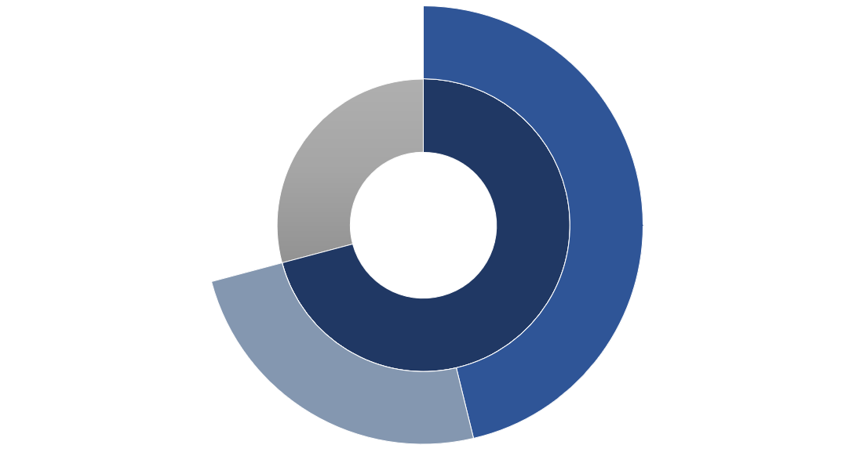
Transparent and sustainable scholarly publishing system? (2019)
Elsevier, Wiley, Taylor & Francis, Springer Nature, Wiley
€475.27 million
Other resources
€289.90 million
Source: 2019 EUA Big Deals Survey Report
Data for 31 consortia in 30 countries
Numbers not including: Article Processing Charges (APCs), consortia other than those participating in the survey and individual institutional contracts with publishers
€1025.25 million
Periodicals
€726.35 million
72% covered by universities
Other publishers
€251.08 million

Slide 15
EUA priorities
Transparency
Achieve more transparency and greater sustainability in the scholarly publishing system :
Need to understand new negotiation models
Read & Publish Agreements : A survey has been launched on the future of the negotiation models with the support of 24 organisations representing national rectors 'conferences, national negotiating consortia and libraries.
Need to be able to compare the cost of subscriptions (mainly Big Deals) and the cost of APC
New EUA ’release :

Slide 16
EUA Signatory to the EOSC Declaration
EUA Involved in OSPP
Open Science skills
Data culture
Promotion of the FAIR principles (Findable, Accessible, Interoperable, Reusable)
Open Access and open standards
Governance
EUA partners with the FAIRsFAIR project (2019-22)
Foster FAIR data practices in Europe
Focus on FAIR competences and policies
Open Science infrastructures
Source:
EOSC Declaration
FAIRsFAIR project

Slide 17
Reviewing research assessment

Slide 18
Research assessment
The European research and innovation landscape is increasingly making research publications and data openly available, creating a need to review university approaches to research assessment:
On the one hand, digitisation reinforces the use of quantitative criteria, and unfortunately of criteria that are too often biased, such as the journal impact factor.
On the other hand, appropriate incentives and rewards will ensure that researchers participate in the process of free access to research.

Slide 19
Gather and share information
Survey report (October 2019)
Engage in dialogue
Workshop (May 2019, Brussels)
Develop policy and good practice recommendations
Briefing on key concepts, issues and actors (April 2019)
Joint statement with Science Europe (May 2019)
Roadmap (June 2018)
Conference with VSNU (November 2019)
EUA events and activities
More information:
EUA Roadmap (June 2018)
EUA Briefing (April 2019)
EUA Workshop (May 2019)
Joint statement with Science Europe (May 2019)
EUA survey report (October 2019)
Conference with VSNU (November 2019)

Slide 20
2019 Open Science and Access Survey
Provides a comprehensive and up-to-date overview of the current state of research assessment in European universities,
Looks at why and how institutions are reviewing their evaluation practices.
Informs and strengthens the discussion on these issues.
Participation
260 valid institutional responses
32 European countries
Source:
2019 EUA Open Science and Access Survey Report
Notes:
The annula survey was focused in 2019 on the institutions' research assessment policies

Slide 21
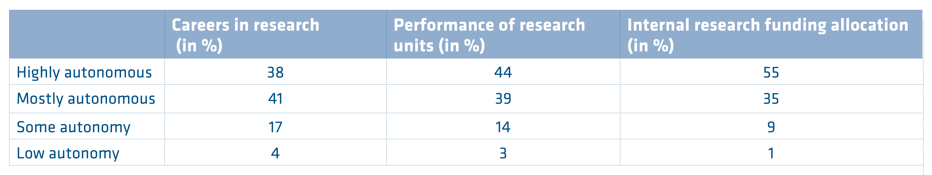
Autonomy to develop and implement institutional approaches to research assessment (2019)
Number of respondents:
197/197 (careers), 183/183 (research units) and 177/177 (funding allocation)

Slide 22
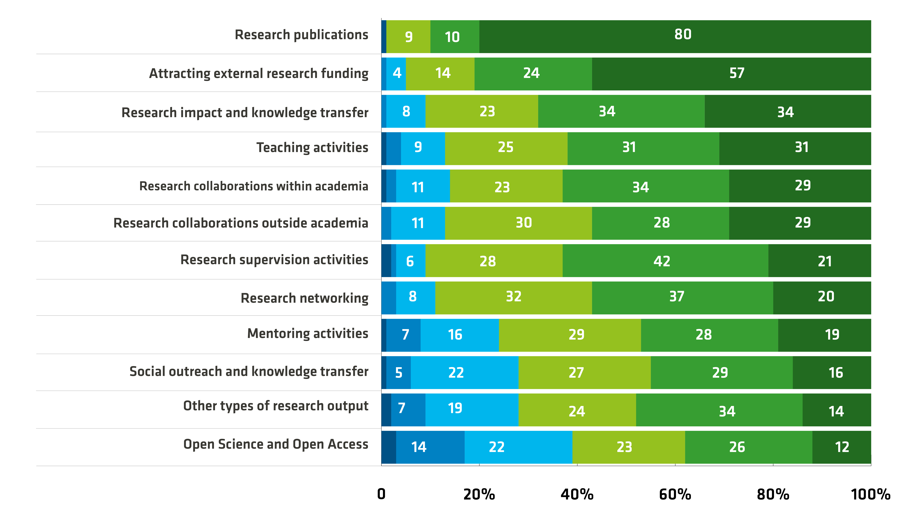
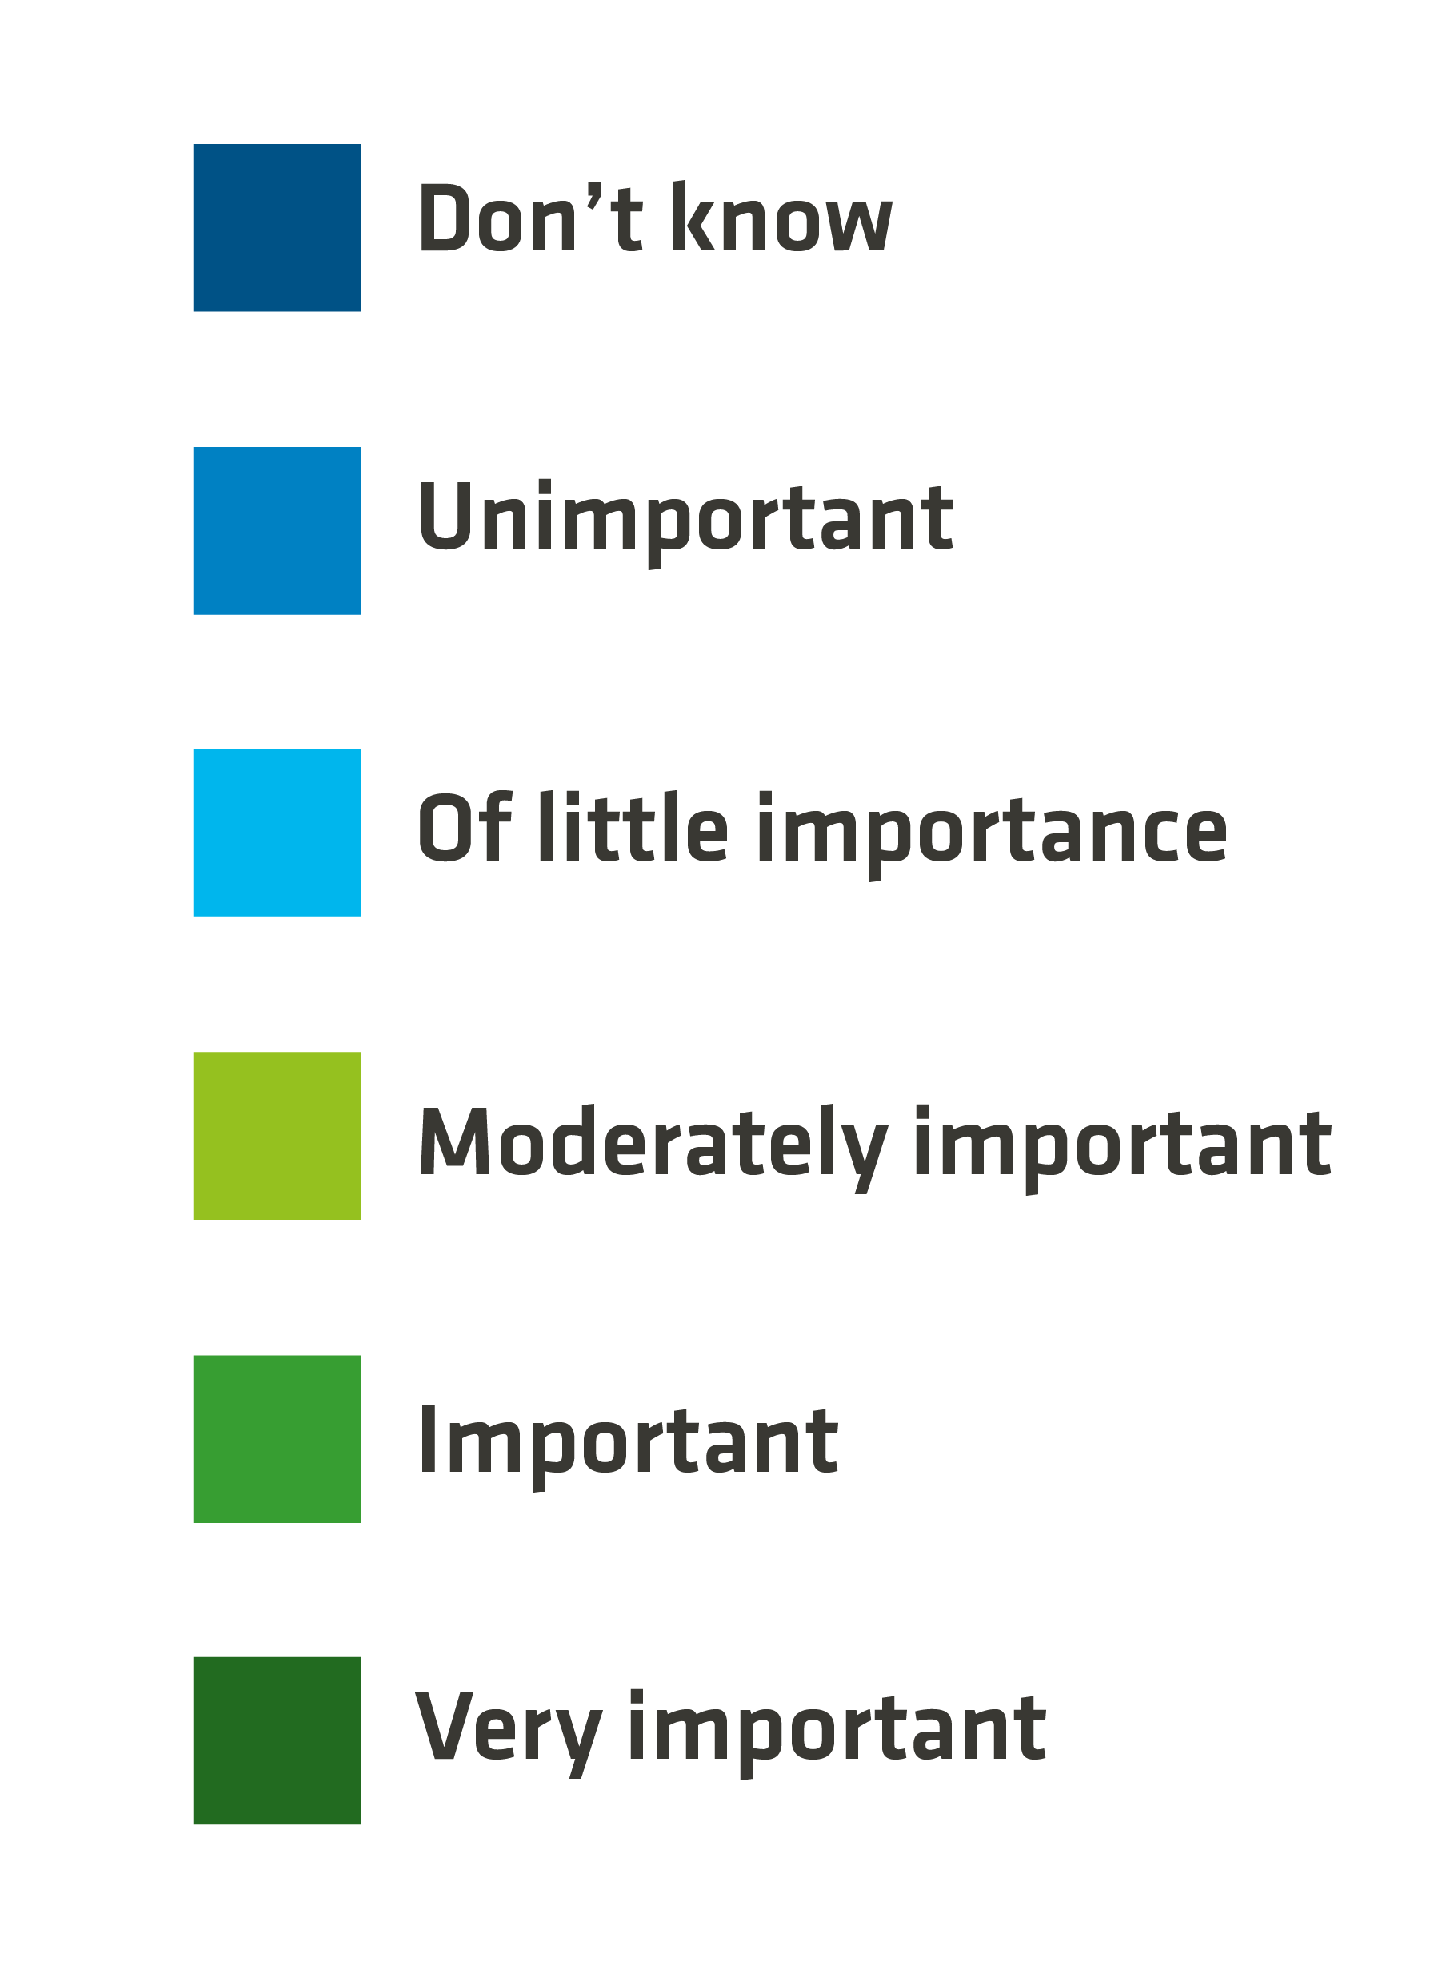
Importance of academic activities for careers in research (2019)
Number of responses:
between 191-195/197

Slide 23
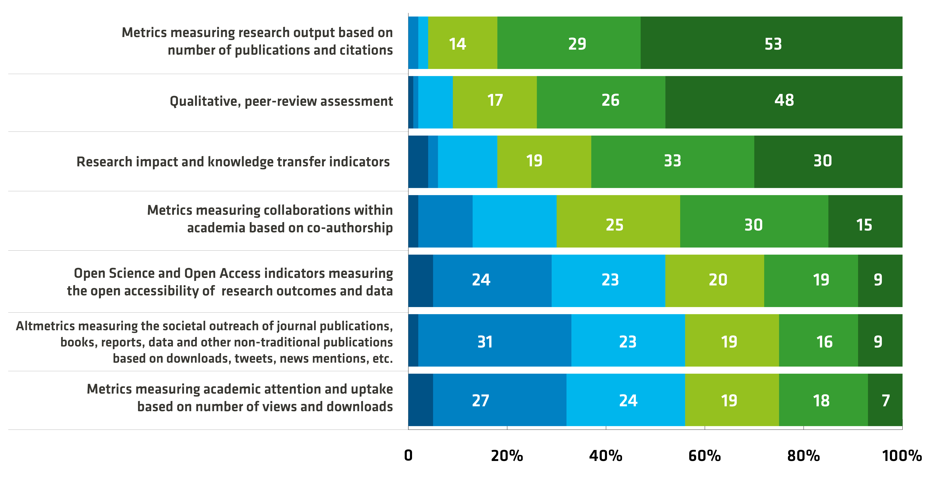
Evaluation of academic activities for careers in research (2019)
Number of responses:
between 194-195/197

Slide 24
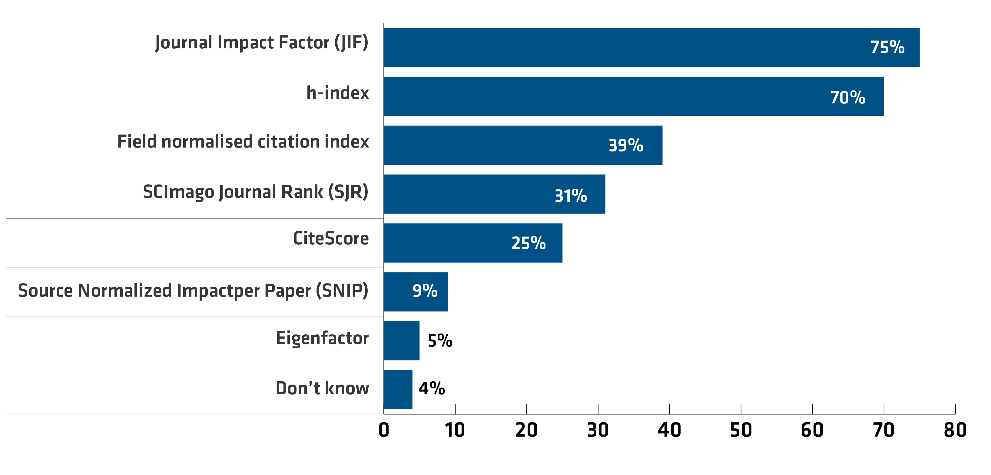
Publication metrics used for careers in research (2019)
Multiple-choice question
Number of responses:
185/186

Slide 25
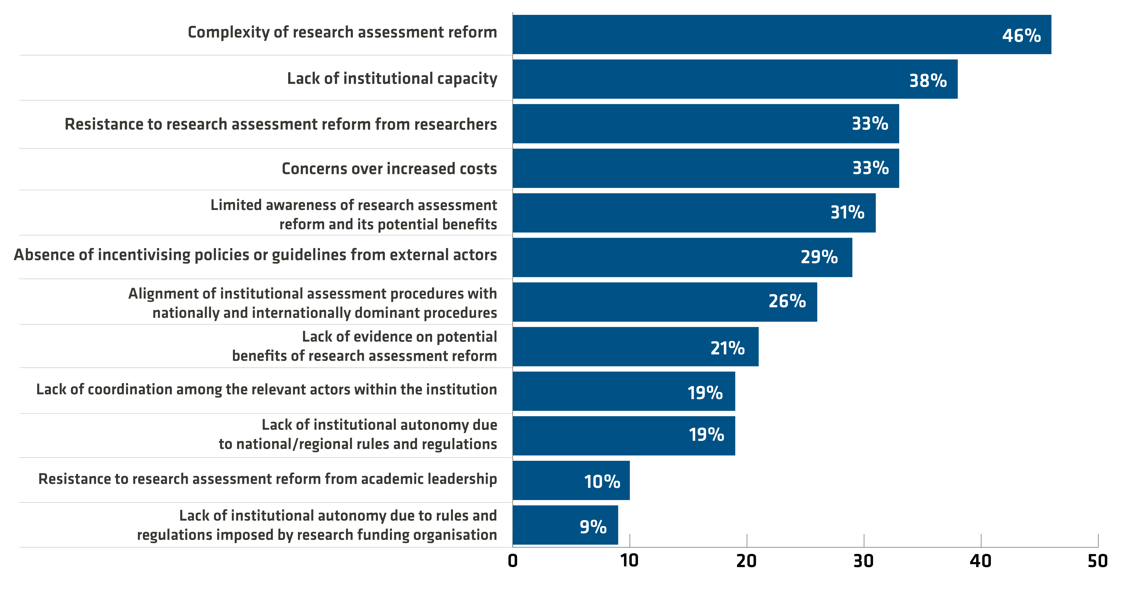
Main barriers and difficulties to review approaches to research assessment (2019)
Multiple-choice question
Number of responses:
233/254

Slide 26
Key survey findings and recommendations
Need to broaden the range of academic activities that are incentivised and rewarded;
Widen the set of evaluation practices
University approaches to research assessment focus on publishing research and attracting external funding
Universities rely on a limited set of evaluation practices which are mostly geared towards assessing research publications, e.g. Journal Impact Factor
Other evaluation practices are less widespread and less developed, e.g. Open Science and Access indicators
Reviewing research assessment is a shared responsibility and requires a concerted approach uniting the main actors
Universities consider themselves largely autonomous to develop and implement approaches to research assessment
Universities are keenly aware of external influences shaping their approaches to research assessment, e.g. governments, research funding organisations, competitive environment

Slide 27
Contact:
jean-pierre.finance@univ-lorraine.fr

Slide 28
Break the cost vicious cycle
Increase in library expenditure
Negotiations under pressure: researchers, institutions
Institutions’ strategies: Collective negotiations
Journal’s prestige (impact factor) Oligopolistic market
Non-disclosure agreements
Publisher’s proposal:
Big Deals
New journals
Additional services
28

