Slide 1
Towards making full and immediate Open Access a reality: the future of Open Access policy
David Sweeney, Executive Chair - Research England

Slide 2
Principles and Declarations
2002: Budapest Open Access Initiative 2002
2003: Berlin Declaration 2003
2013 and 2015 (updated): Science Europe Open Access Principles
2016: European Council conclusions calling to reach goal of immediate Open Access by 2020
2016: OA2020 Initiative

Slide 3
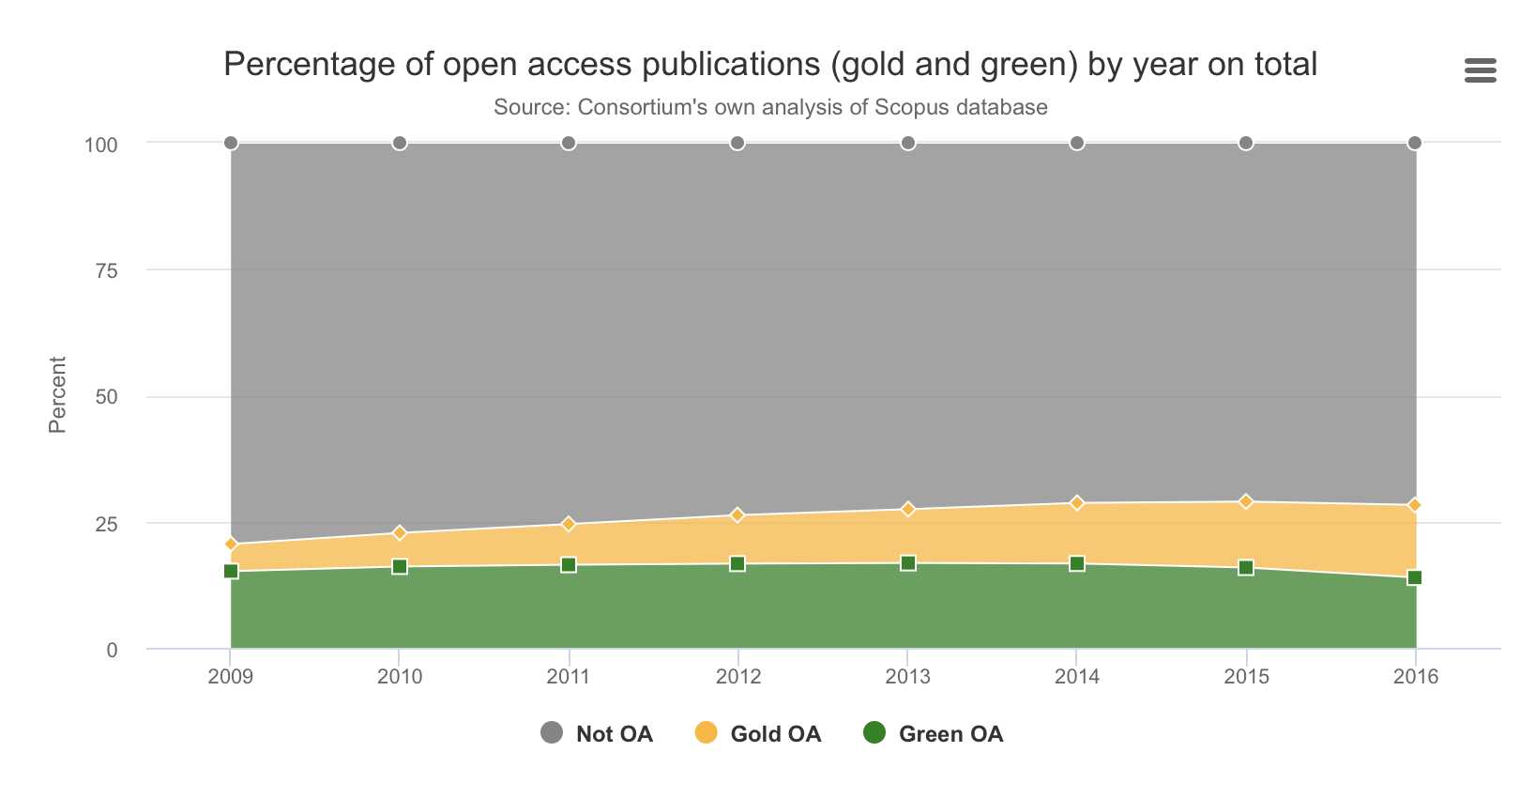
The Reality...

Slide 4
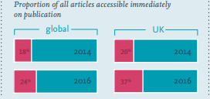
The Reality...
Current approaches to OA – including support for hybrid – not bringing about the transformation we seek
Estimated that 76% of research published in 2016 is behind a paywall on publication

Slide 5

The Open Access Envoy of European Commission’s mandate
28 February 2018
The Council Conclusions of 27 May 2016 on the transition towards an Open Science system state that all publicly funded scientific publications should be available in Open Access by 2020;
The 2020 target is an achievable but demanding target, which can only be met with a clear roadmap, efficient coordination with Member States and an active dialogue with the publishing industry and other interested stakeholders;
Decision to appoint a Senior Adviser for Open Access and Innovation to report on the state of play on Open Access in the EU and third countries and to come with concrete policy recommendations for the Commission by 30 June 2019;
You will report to me, Vice President Ansip and Vice-President Katainen.

Slide 6
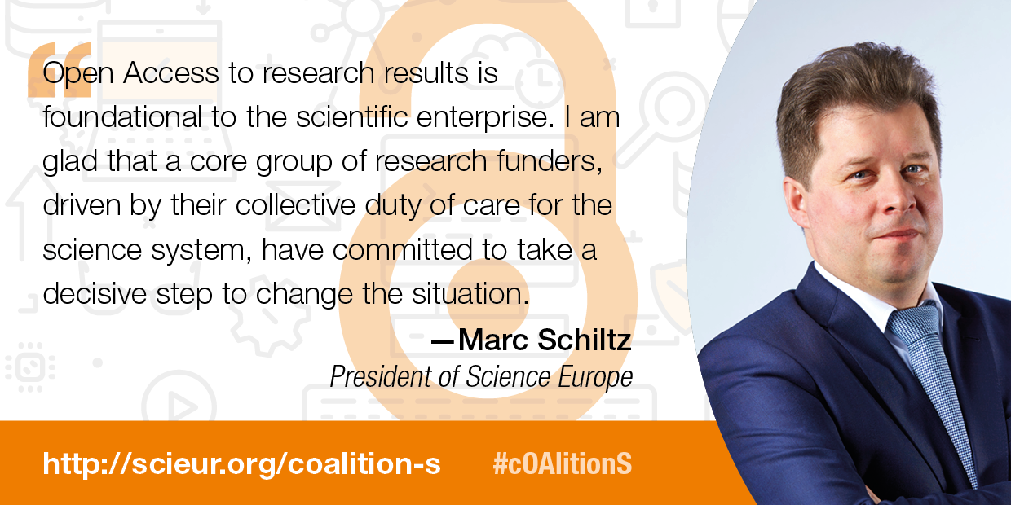
The Motivation

Slide 7
One Main Shared Objective
“After 1 January 2021 scientific publications on the results from research funded by public grants provided by national and European research councils and funding bodies, must be published in compliant Open Access Journals or on compliant Open Access Platforms.”

Slide 8
cOAlition S aims for:
Full and immediate Open Access (OA) to publications from publicly funded research
Shift towards new models of academic publishing
A system for scholarly publications that is more transparent, efficient and fair
A culture that ensures that young scholars have opportunities to excel and advance their careers
cOAlition S invites research funders, institutions, researchers, learned societies, and publishers to work together to make this happen

Slide 9



Plan S : Built on strong principles
Publication fees should be transparent and reasonable (Principle 5)
Funders commit to support such publication fees, individual researchers do not pay (Principle 4)
Multiple routes to OA compliance (Principle 5)
Commitment to assess research outputs based on their intrinsic merit and NOT their venue of publication, following DORA (Principle 10).

Slide 10
Plan S : Built on strong principles
No publication should be locked behind a paywall OA must be immediate, i.e. no embargo periods No copyright transfer; publication under a CC BY license by default Transparency about pricing and contracts Funders commit to support publication fees at a reasonable level Multiple routes to OA compliance Commitment to assess research outputs based on their intrinsic merit and NOT venue of publication

Slide 11

cOAlition S: Who is Involved?
24 members from across Europe, North America, Africa and the Middle East. National funders: Austria: FWF Finland: AKA France: ANR Ireland: SFI Italy: INFN Jordan: HCST Luxembourg: FNR Netherlands: NWO Norway: RCN Poland: NCN Slovenia: ARRS South Africa: SAMRC Sweden: FORMAS Sweden: FORTE Sweden: VINNOVA UK: UKRI Zambia: NSTC | Charitable foundations: Wellcome Trust, UK The Bill & Melinda Gates Foundation, USA World Health Organisation TDR Aligning Science Across Parkinson’s (ASAP) Supported by: European Commission European Research Council Coordinated by:

Slide 12
The 10 Principles of Plan S
Authors retain copyright of their publication with no restrictions. All publications must be published under an open license, preferably the Creative Commons Attribution License CC BY. In all cases, the license applied should fulfil the requirements defined by the Berlin Declaration; The Funders will ensure jointly the establishment of robust criteria and requirements for the services that compliant high quality Open Access journals and Open Access platforms must provide; In case such high quality Open Access journals or platforms do not yet exist, the Funders will, in a coordinated way, provide incentives to establish and support them when appropriate; support will also be provided for Open Access infrastructures where necessary; Where applicable, Open Access publication fees are covered by the Funders or universities, not by individual researchers; it is acknowledged that all scientists should be able to publish their work Open Access even if their institutions have limited means; | When Open Access publication fees are applied, their funding is standardised and capped (across Europe); The Funders will ask universities, research organisations, and libraries to align their policies and strategies, notably to ensure transparency; The above principles shall apply to all types of scholarly publications, but it is understood that the timeline to achieve Open Access for monographs and books may be longer than 1 January 2020; The importance of open archives and repositories for hosting research outputs is acknowledged because of their long-term archiving function and their potential for editorial innovation; The ‘hybrid’ model of publishing is not compliant with the above principles; The Funders will monitor compliance and sanction non-compliance.

Slide 13
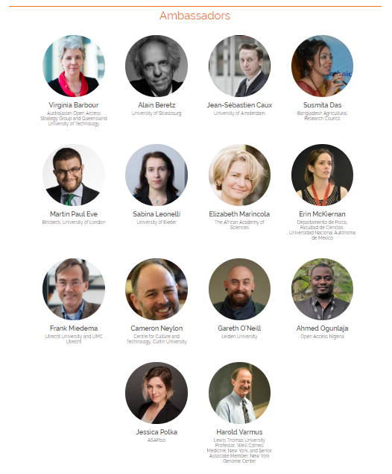
Working with key stakeholders: researchers
Working with researcher groups to ensure we understand their concerns and find ways of mitigating them
Seeking to work with Global Young Academy (and others) on developing indicators to measure impact of Plan S on ECR’s. A Task Force has been established to progress this.
Ambassador network established – to engage with research community and share concerns with cOAlition S leadership team

Slide 14
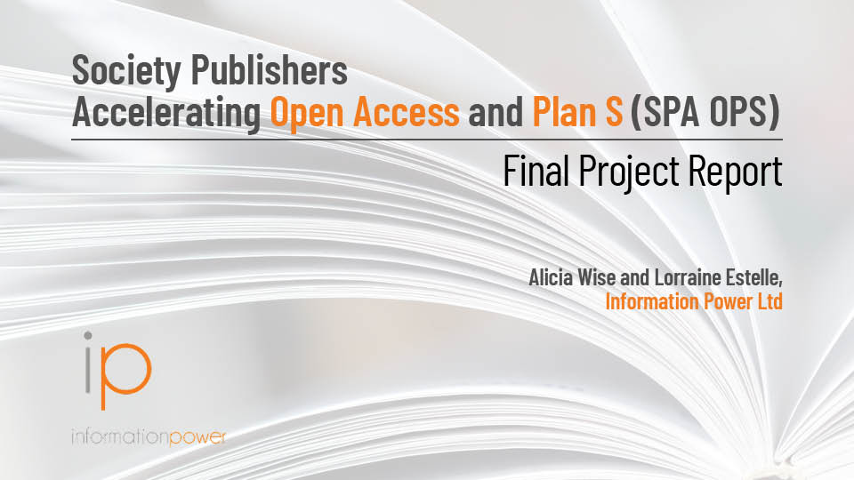
Working with key stakeholders: learned societies
Wellcome and UKRI, in partnership with ALPSP have funded a study to explore alternative business model for learned society publishers
Key deliverables are a report containing 27 business models and strategy and a model transformative agreement with an implementation toolkit
Expectation is that a number of Societies will use this Agreement to offer TA’s as early as 2020
Report, model Agreement and implementation toolkit to be published on 12th September
https://wellcome.figshare.com/

Slide 15
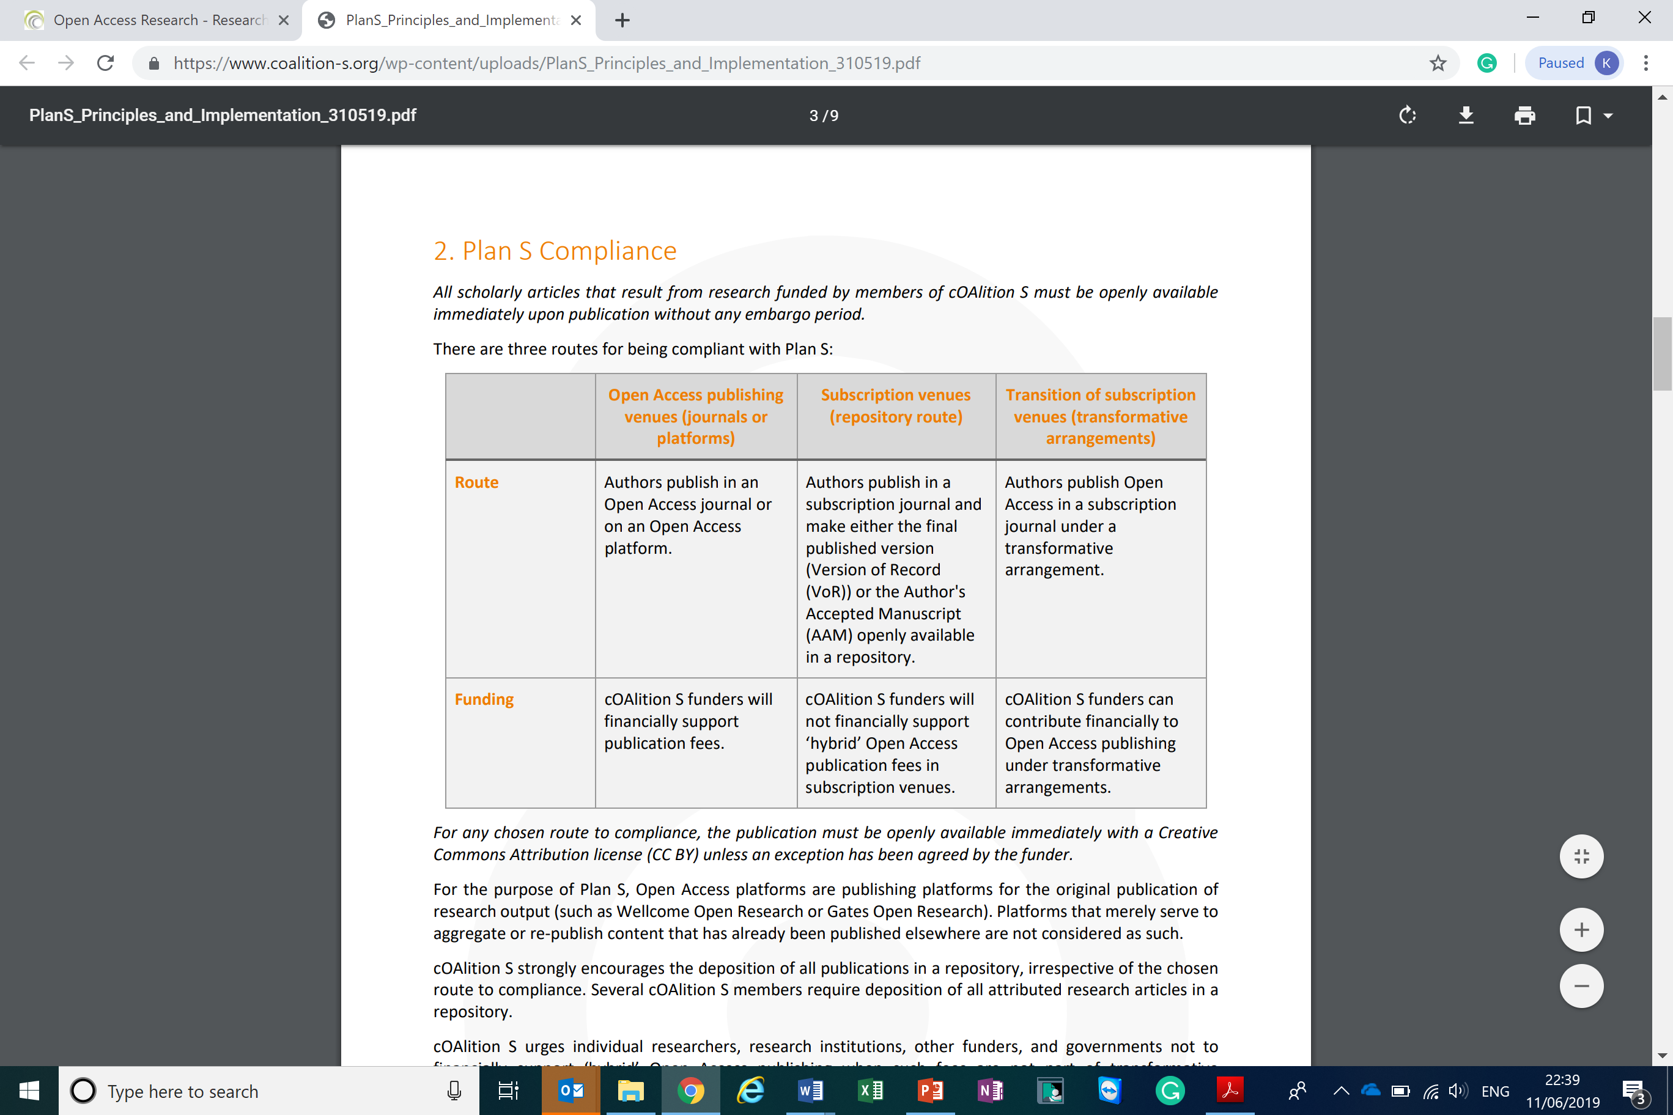
Three routes for compliance
CC-BY 4.0 license required. Rights retained by author/institution
Scholarly articles reviewed according to the standards within the relevant discipline, and according to the standards of the Committee on Publication Ethics (COPE)

Slide 16
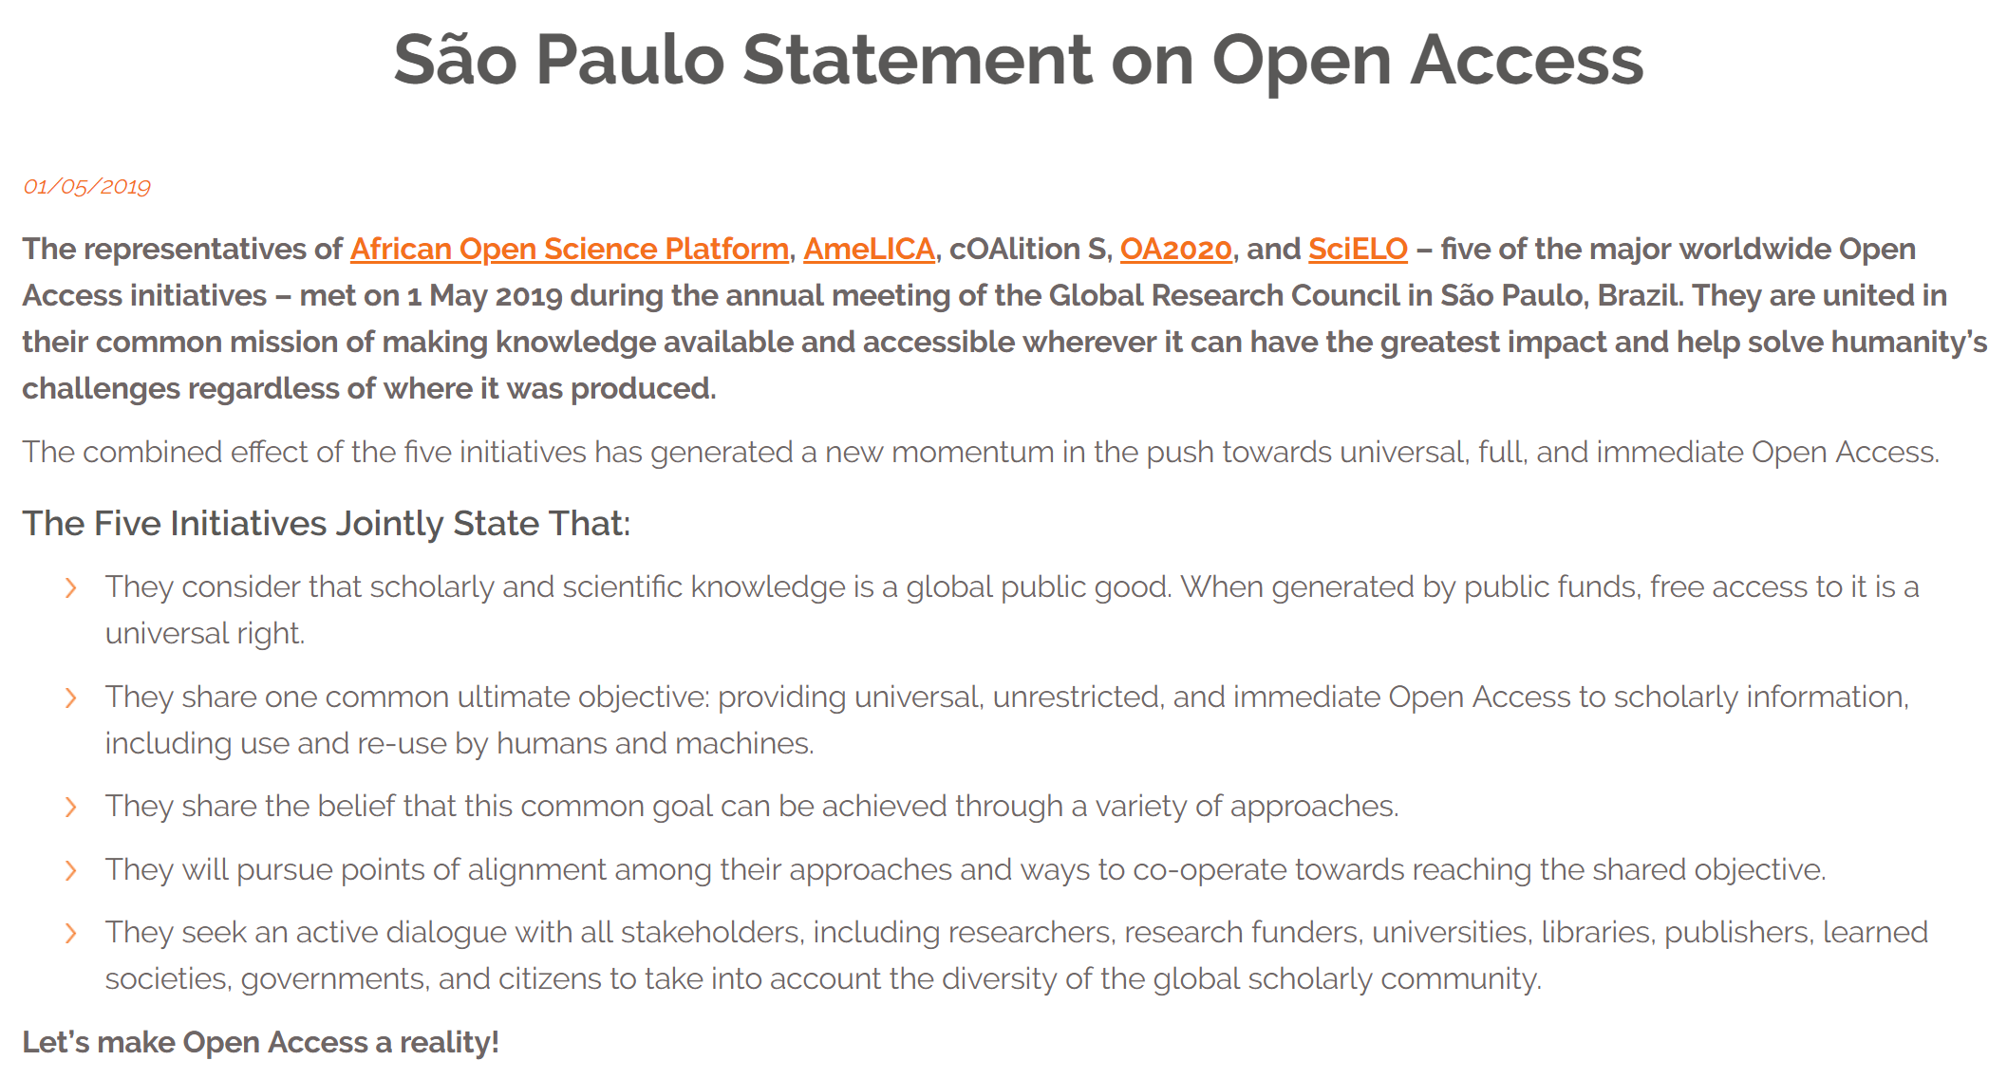
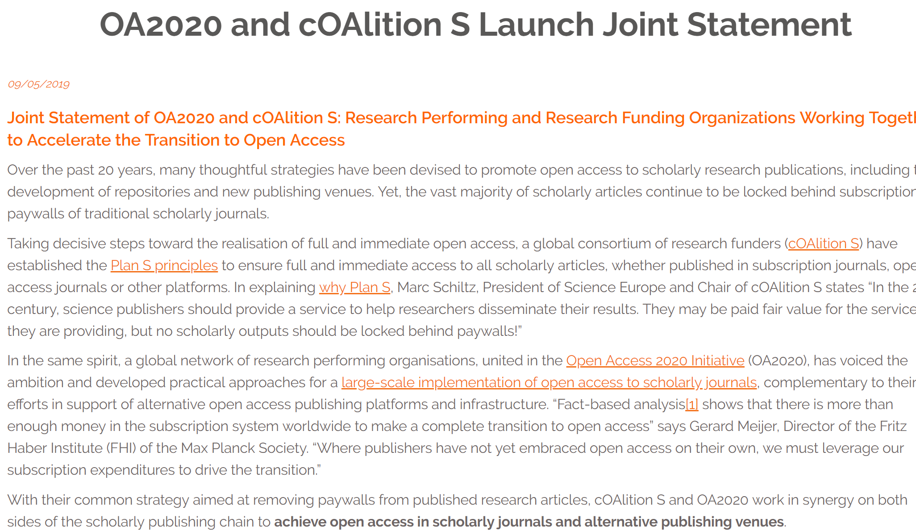
Working with key stakeholders: other OA initiatives
Plan S is acting as a spur to encourage a transition to OA – as witnessed by the upsurge in transformative agreements

Slide 17
Timeline:
Plan S launched in September 2018;
cOAlition S invited stakeholders to give feedback on its draft implementation guidance (November 2018 - February 2019);
Over 600 responses received and analysed. Largest ever international consultation that has been conducted on an Open Access policy.
cOAlition S Leaders adopted final implementation guidelines in May 2019;
cOAlition S members will now start implementation;
Mid-term goal: change the way we assess and reward science.

Slide 18
Significant updates
OA2020 and cOAlition S launch joint statement – call to withdraw support from paywall publishing and to ensure open access in scholarly research publications.
São Paulo statement on Open Access from the five initiatives which generates new momentum towards universal, full and immediate Open Access.
The Higher Council for Science (HCST – Jordan) joins cOAlition S – first organisation in the Middle East to do so
The University of California System cancels subscription contract with Elsevier
Projekt DEAL and Wiley publish the ‘Publish&Read’ agreement
cOAlition S welcomes its first African member and receives strong support from the African Academy of Sciences
Diverse and global feedback provided on the Implementation Guidance of Plan S: 600+ individuals/organisations. Analysis of feedback underway – initial analysis expected in the Spring
Robert-Jan Smits finished his mandate. Robert Kiley (Wellcome Trust) acts as interim coordinator
Plan S Ambassadors announced.

Slide 19
Significant updates continued
Johan Rooryck appointed as Open Access Champion.
World Health Organisation (WHO) and the Special Programme for Research and Training in Tropical Disease (TDR)
Jean-Claude Burgelman nominated to cOAlition S Executive Steering Group
Wellcome in partnership with UKRI, and on behalf of cOAlition S appoint Information Power to lead a collaborative project with publishers, funders, and universities to develop a framework to help make OA publishing services more transparent.
Launch of report and toolkit, commissioned by Wellcome and UKRI in partnership with ALPSP, launched.
Aligning Science Against Parkinson’s (ASAP) joins cOAlition S
Commitment from COAR and cOAlition to work together to support repositories
South African Medical Research Council (SAMRC) joins cOAlition S.

Slide 20
Support mechanisms for establishing OA Journals/Platforms and open infrastructures
cOAlition S will:
commission a gap analysis of Open Access journals to identify fields and disciplines where there is a need to increase the share of OA journals.
collectively provide incentives for establishing OA journals/platforms or flipping existing journals to OA, in particular where there are gaps and needs.

Slide 21
Open Access Publication fees (APCs)
Recognise the importance of ‘fee-free’ OA Journals and Platforms (‘free to read – free to publish’)
Pay a fair and reasonable APC level that reflects the costs involved in the quality assurance, editing and publishing process,
APC waivers for authors from low-income countries and discounts for authors from middle-income countries
Calls for full transparency and monitoring of Open Access publication costs and fees.
To help inform the potential standardisation of fees and/or APC caps, cOAlition S will commission an independent study on OA publication costs and fees (including APCs)

Slide 22

Transformational Agreements (APCs)
Temporary and transitional
Authors retain copyright
Agreements must be transparent
Aim to constrain costs of scholarly communication
Foster equity in scholarly publishing
Address the needs of authors and administrators (governance/workflow)

Slide 23
Open archives and repositories - requirements for authors and publishers
A copy of the published work must be openly available in a compliant repository under the Plan S conditions without cost for the depositor/author if it is not available in an OA journal or platform
Version of Record (VoR) or at least the Author’s Accepted Manuscript (AAM); no embargo period; Authors/ institutions must retain copyright and articles available under CC BY 4.0 license
The self-archiving ('green OA') policy of the venue must be registered in Sherpa/Romeo
The repositories must be registered in the directory of open access repositories open DOAR or in the process of being registered.

Slide 24
Issues raised during consultation
The position of the Learned Societies
The role of repositories
Changing the academic culture – DORA
Re-directing the money flows

Slide 25
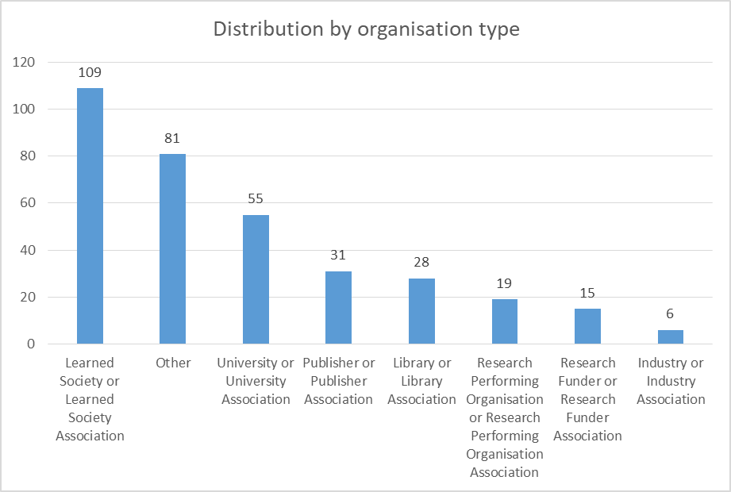
Feedback Responses: 344 Institutional and 263 Individual
Individuals: 213 researchers, 15 librarians, 35 others

Slide 26
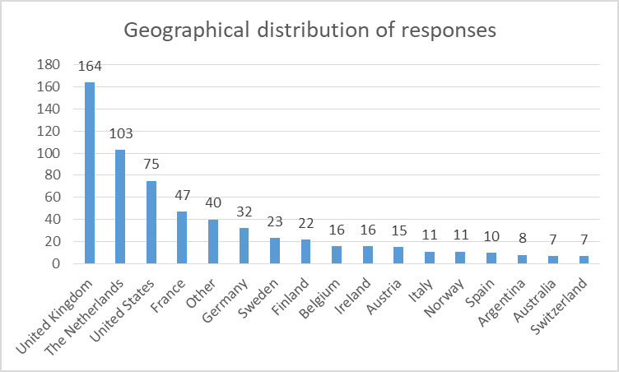
Feedback Responses:

Slide 27
Feedback Analysis:
Dedicated task force reviewed feedback and updated the Plan S principles and implementation guidance. Chaired by John-Arne Røttingen, RCN, and David Sweeney, UKRI, and comprising experts from cOAlition S members;
Further review by cOAlition S members, external organisations, and OA experts;
Final approval of the revised Plan S principles and implementation guidance and by cOAlition S Leaders in May 2019.

Slide 28
Fundamental Principles Remain:
No scholarly publication should be locked behind a paywall;
OA should be immediate, i.e., without embargoes;
Full OA is implemented by the default use of a Creative Commons Attribution licence (CC-BY)
Funders commit to support OA publication fees at a reasonable level;
Funders will not support publication in hybrid (or mirror/sister) journals unless they are part of a transformative arrangement with a clearly defined endpoint

Slide 29
Plan S Principles – Main Changes:
cOAlition S has now become a global movement;
Principle 5 (APC caps): focus on the transparency of prices – Funders retain the right to introduce a cap in the future;
Hybrid OA is not compatible but as a transitional pathway towards full OA, publishing in subscription journals as part of transformative arrangements is compliant;
The ‘green route’ is Plan S compliant;
Principle 10: funding decisions should be based on the intrinsic merit of the work and not journal proxies (journal name or its impact factor).

Slide 30
Implementation Guidance - Main Changes:
Timeline extended by one year:
Calls published as of 1 January 2021 onwards
Transitional arrangements will be supported until 2024;
Options for transitional arrangements are supported (transformative agreements, transformative model agreements, and ‘transformative journals’)
Greater clarity on compliance routes:
cOAlition S supports a diversity of business models
Plan S is NOT just about Gold OA;

Slide 31
Implementation Guidance – Main Changes:
cOAlition S funders commit to adapt researchers’ assessment criteria and will implementation principles of the San Francisco Declaration on Research Assessment (DORA);
Greater emphasis on the transparency of OA publication fees to inform potential standardisation and capping of payments
Possibility to apply for a CC-BY-ND licence (no derivatives) as an exception
Technical requirements for repositories revised

Slide 32
Other activities – Transparent Pricing
Plan S Guidance specifies: “cOAlition S, in partnership with publisher representatives and other stakeholders, will define the various services (e.g., triaging, peer review, editorial work, copy editing) publishers will be asked to price.” Wellcome - in partnership with UKRI and on behalf of cOAlition S - have appointed Information Power to lead a collaborative project to develop a framework for these communications cOAlition S aims to help make the nature and prices of OA publishing services more transparent, and to enable conversations and comparisons that will build confidence amongst customers that prices are fair and reasonable The project will not explore costs, nor current or future pricing.

Slide 33
Other activities – cOAlition S Secretariat
Establishing a formal cOAltion S Secretariat /Office to ensure that we can appoint staff, award contracts etc to take forward the work associated with the implementation of Plan S Budget defined – which will be funded by cOAlition S members who are able to make a financial contribution No obligation for cOAlition S funders to make a financial contributions Office expected to be up and running by January 2020

Slide 34
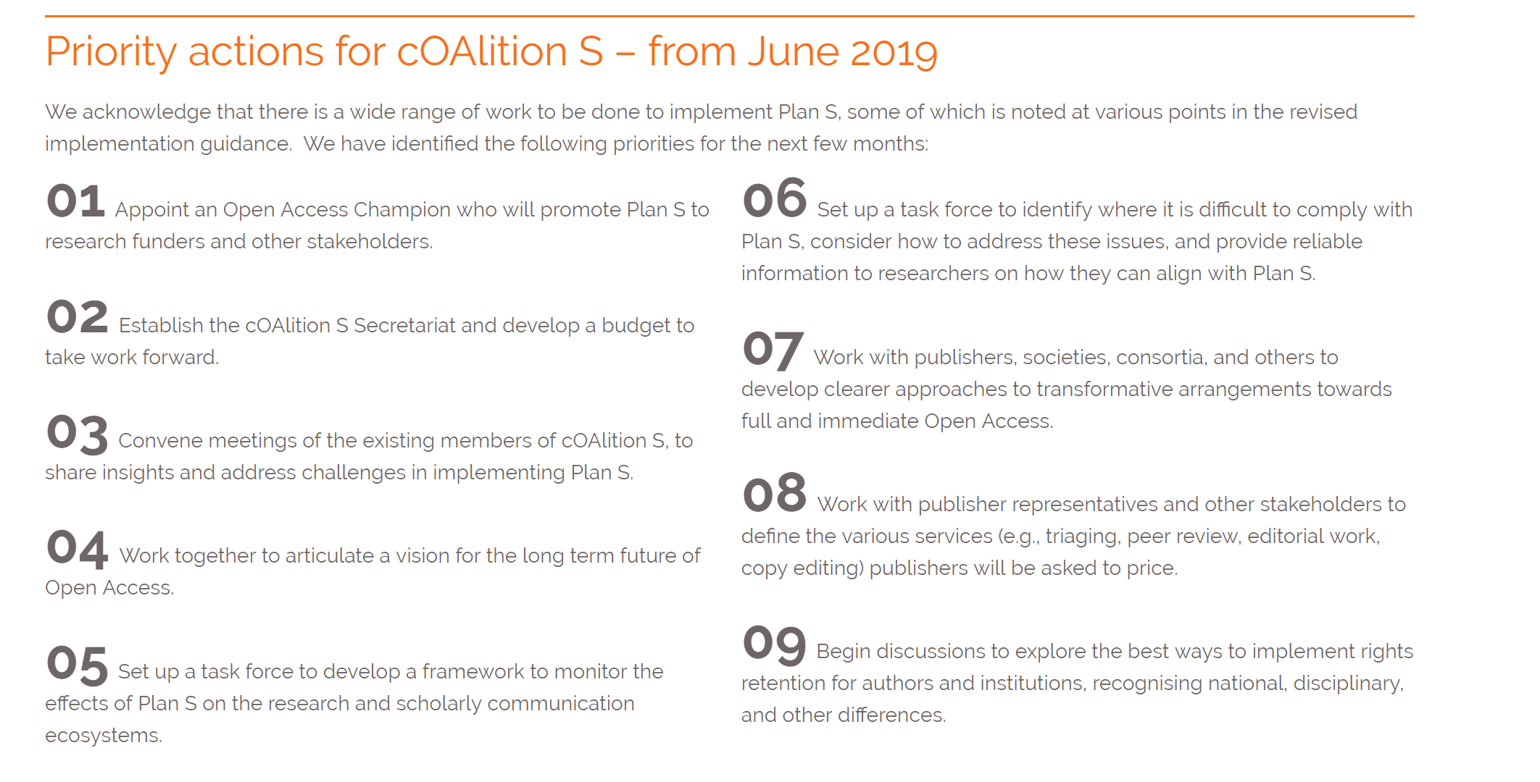
Other activities
https://www.coalition-s.org/workplan/

Slide 35
Why Support Plan S
To democratise access to publicly funded knowledge: not a single person should be left behind
To optimise the dissemination and exploitation of knowledge by allowing others (including machines) to build on the results of their peers and to allow all researchers to access knowledge generated in other parts of world
To show that you are eager to serve mankind with your knowledge

Slide 36
Further Details:
Revised Plan S principles and implementation guidance: http://bit.ly/2M3Z6E3
Rationale for the revisions made to the Plan S principles and implementation guidance: http://bit.ly/2JYVTmu
cOAlition S participating funders: http://bit.ly/2M5XSZ0

Slide 37
For More Information:
https://www.coalition-s.org/
Twitter: DSweeneyUK
Email: David.Sweeney@re.ukri.org
Thank you for your attention!

